Slide 1

DDoS Attack Detection System:
PYDOS
Prepared by MUHAMMAD MUJEEB
Github: Mujeeb4 Website: whoismujeeb.dev

Slide 2
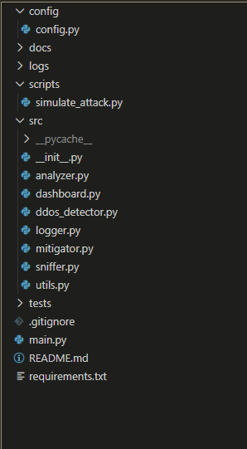
Project Description
A Python-based real-time DDoS detection and mitigation system using traffic analysis, firewall integration, and comprehensive monitoring. This system monitors network traffic in real-time, detects potential DDoS attacks using threshold-based rules, automatically mitigates threats by blocking malicious IPs using iptables, and provides beautiful monitoring dashboards with comprehensive logging.

Slide 3






1. Tech Used
Joblib
Used for OS level operations such as parallel computing
Pandas
Used for data manipulation
Pytest
Used to create tests for system
The project is based on python with the following libraries for their certain functionalities
Scapy
Use to capture packets in realtime
flask
Used to create the real-time dashboard.
Rich
Visual presentation in terms of tables and graphs

Slide 4
What is DoS and DDos
And how does PYDOS
Saves us from it?

Slide 5
Just PYDOS running! And Bam!!
Just run pydos in your linux server and forget about requests above threshold and uptimes

Slide 6
WE STILL DIDN’T GET IT, WHAT IS PYDOS
Capture: Uses Scapy to intercept packets in real-time.
Analyze: Checks packet count and weight against defined thresholds.
Block: Automatically uses iptables to block malicious IPs.
Monitor: Provides a real-time dashboard for comprehensive logging.

Slide 7
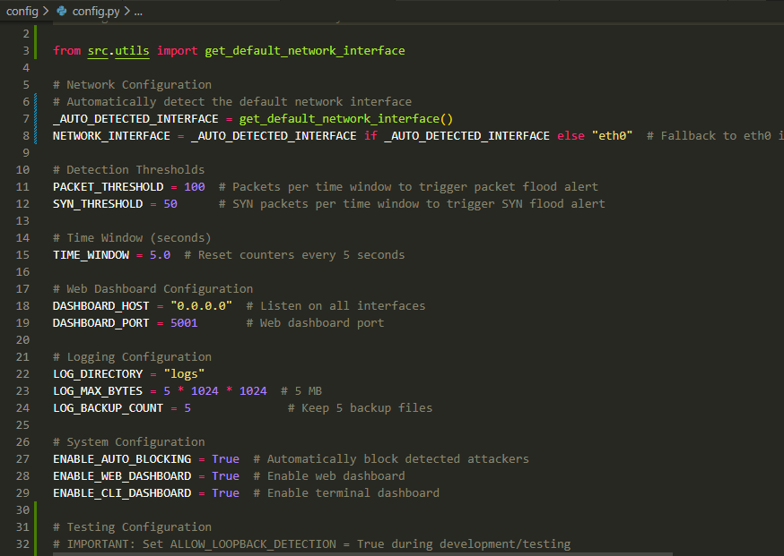
IT’S ALL ABOUT THE GAME OF CONFIG

Slide 8
HELL NO!!
I DON’T WANT TO CONFIGURE EVERY TIME I USE PYDOS
WHO TOLD YOU TO DO SO?

Slide 9
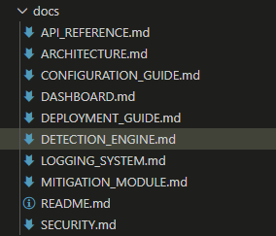
YOU MISSED SOMETHING WE NEED MORE DETAILS

Slide 10

THANK YOU!!
MARKS

